Slide 1

Data Mining & Text Mining Project
Tara Tandel
Ghodrat Rezaei
Saeid Rezaei

Slide 2





Preprocessing
Data Quality Assurance
To identify information that cannot be used for the prediction.
Feature Aggregation
To create a single global feature by aggregating some other features.
Outlier analysis
To create brand new feature out of the original features.
Feature Selection :
Should I really explain this? Isn’t it self-evident? To select the most useful/interesting/contributing features.
1
2
3
4

Slide 3
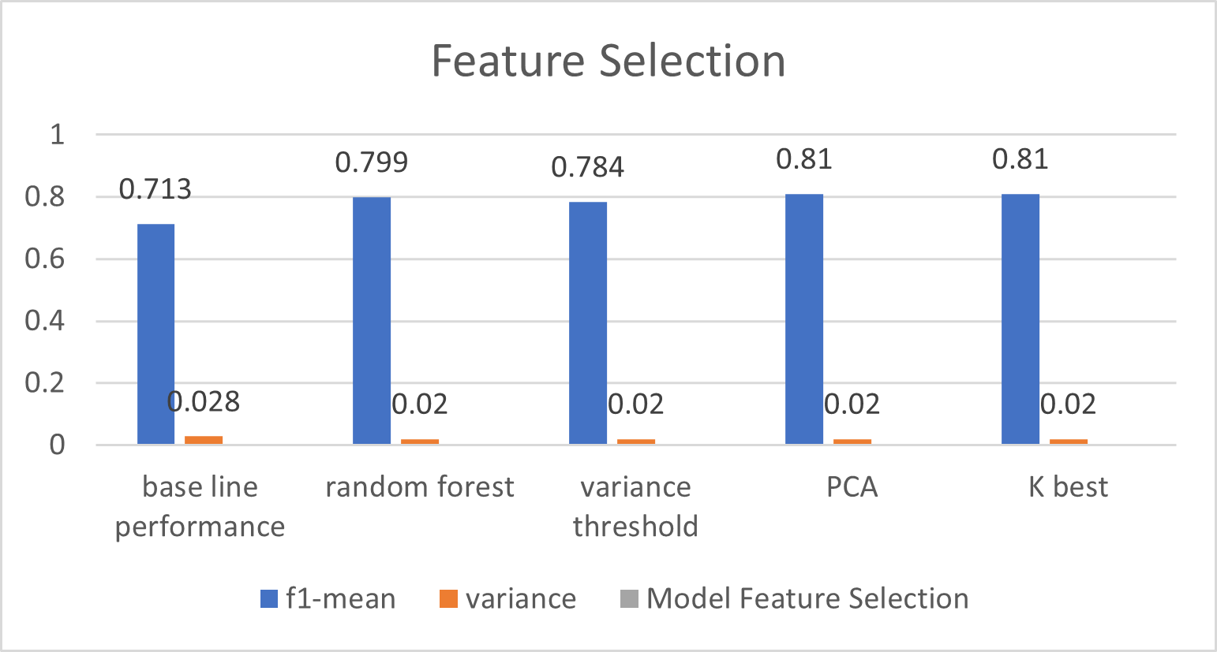
Feature Selection
Difference Models are used for feature selection on the oversampled dataframe.
PCA with 32-main-components gives the best performance.

Slide 4
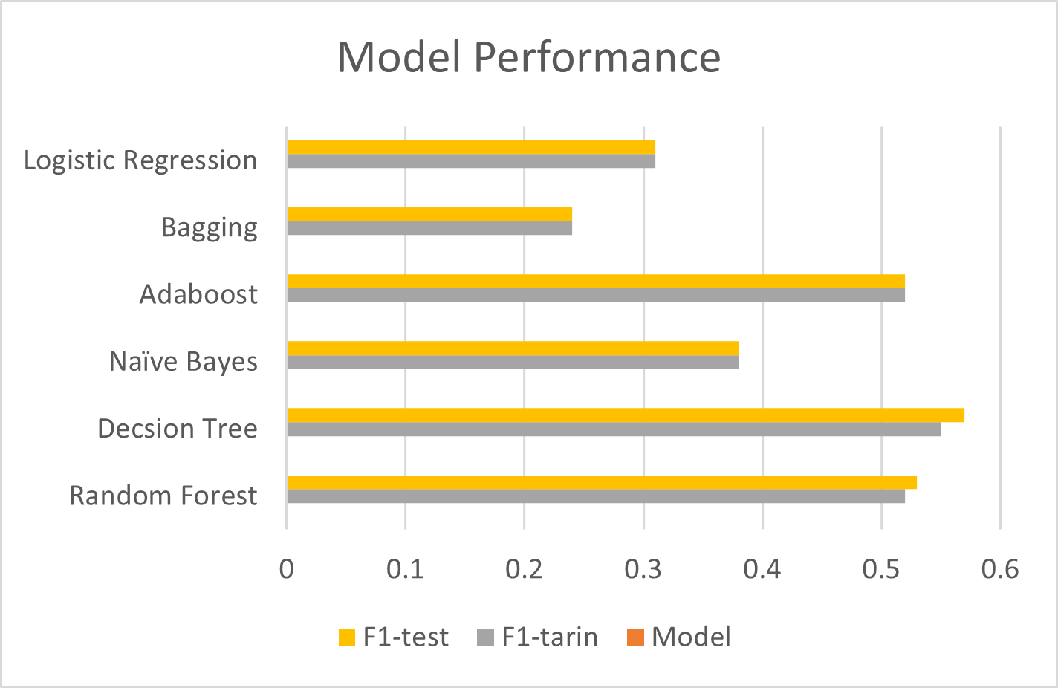
Prediction Model
Grid-search for the best model over various models
Iterating over the parameters and picking up the best parameters which give us the minimum error.
The best model was Decision Tree model. Final performance.

Slide 5
Model Performance
Our hypothesis is that failure causes are similar in both training and test set, as they both are drawn from the same distribution.
Best model was DecisionTreeClassifier with Max-Depth=3, ‘Learning-Rate’=1,
n-estimator = 50. We could have used better numbers but due to the limit in processing, we remained content with these numbers.
The final performance in terms of Recall was 0.02.
Suggestion: using the slided window for feature selection.

Slide 6
Thank You ☺

